Slide 1

IBM Project Presentation on “Cloud Based Human Activity Recognition System”
By
Group ID: G-19
Team Members Name & Enrollment No:
Dhruv Jethwani - 22162171008
Viraj Patel - 22162121018
Krish Patel - 22162581006
Under the guidance of
Mr. Nirav Rajgor, Mr Kunal Garud
Institute of Computer Technology, Ganpat University
Date: 8 April 2026

Slide 2
Problem & Solution
What we identified · How we solved it
⚠ THE PROBLEM
✅ OUR SOLUTION
👁 No Automated Monitoring
🤖 AI-Powered Recognition
No scalable system to detect and log human physical activities in real time from image inputs.
EfficientNetB3 model analyses uploaded images via Gradio and returns activity labels with confidence scores.
⚡ Manual Processes Fail at Scale
☁️ Cloud-Native Platform
Human observation is error-prone, expensive, and impossible to deploy across large environments.
Flask backend on Render + React frontend on Vercel — always available, auto-scaling, zero server management.
🏥 Critical Industries Underserved
🎫 Auditable History Log
Healthcare, fitness, and workplace safety sectors lack an affordable AI-driven activity analysis tool.
Every prediction is stored with a unique Ticket ID in TiDB Cloud MySQL with image URL for full traceability.
2

Slide 3
System Architecture
End-to-end request flow — from upload to prediction
User
Frontend
Flask API
ML Model
Database
Browser
/ Mobile
React + TS
Vercel
Python
Render
EfficientNetB3
Gradio
MySQL
TiDB Cloud
ImgBB
Image Storage
1. Upload image
2. POST /upload_image
3. Call Gradio ML
4. Return prediction
5. Save + respond
Request / Response Flow
3

Slide 4
Tech Stack
Every technology powering HAR-Cloud
⚛ Frontend
🐍 Backend
🗄 Database
React 18 + TypeScript
Python 3.10+
MySQL via TiDB Cloud
Vite (build tool)
Flask + Flask-CORS
SQLAlchemy ORM
Tailwind CSS
Flask-SQLAlchemy
pymysql driver
react-hook-form + Zod
Flask-Login
Serverless cloud DB
Vercel deployment
Render deployment
🤖 ML / AI
☁ Cloud & APIs
🛠 Dev Tools
EfficientNetB3 (Kaggle)
ImgBB API (image host)
python-dotenv
Gradio Client API
Render (backend)
ESLint + TypeScript
Hugging Face Space
Vercel (frontend)
Git + GitHub
Pillow (preprocessing)
TiDB Cloud (DB)
npm / pip
4

Slide 5
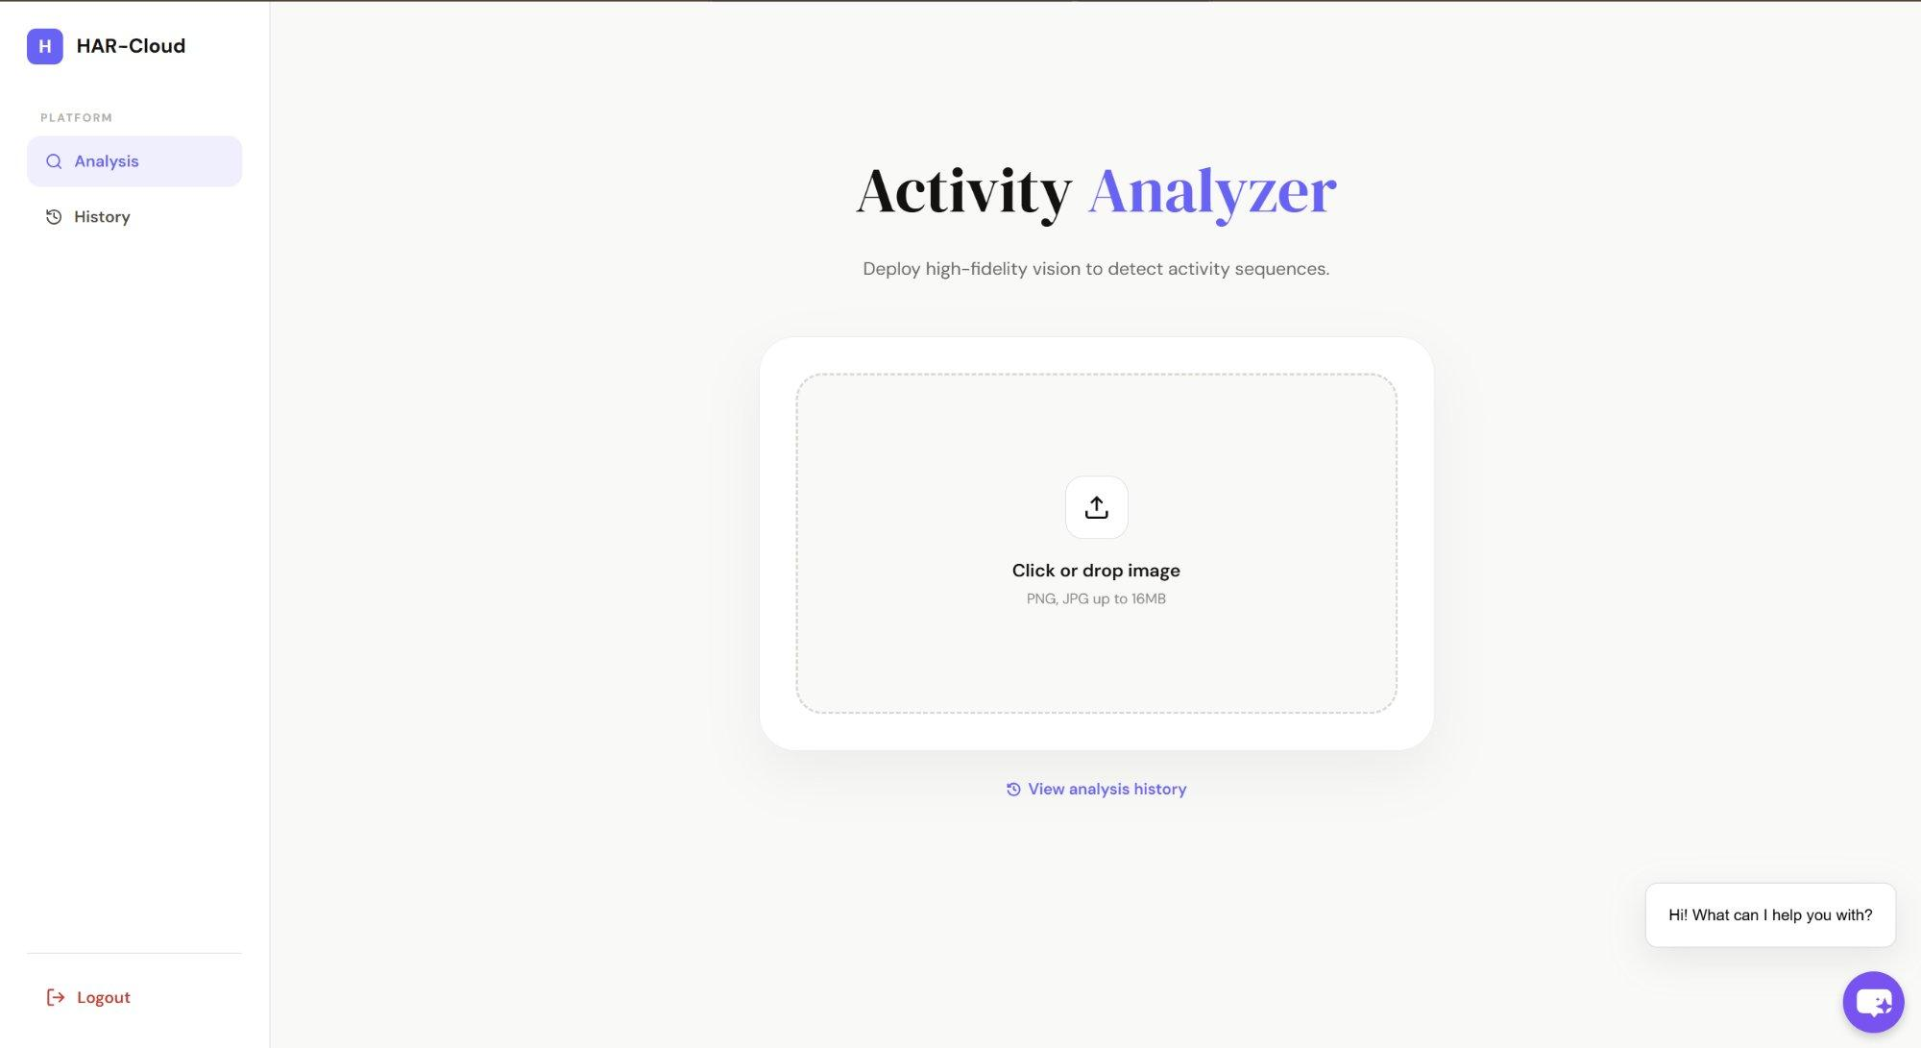
Frontend
React 18 · TypeScript · Vite · Tailwind CSS
🔐 Login & Register
Live Application — HAR-Cloud
Zod schema + react-hook-form validation
📤 Activity Analyzer
Drag-and-drop image upload (PNG/JPG ≤16MB)
📊 Result Display
Activity label, confidence score & Ticket ID
📜 History Page
View past analyses, filter by date/Ticket ID
💬 AI Chatbot
Integrated chatbot assistant (bottom-right)
🌐 har-ibm.vercel.app
🚀 Vercel Deploy
har-ibm.vercel.app · Auto-deploy on push
5

Slide 6
Backend & Database
Flask REST API · MySQL (TiDB Cloud) · ImgBB
API Endpoints
Database Models
Method
Route
Purpose
👤 User
GET
/api/test
Backend health check
id
Integer
PK
fullName
String(100)
POST
/api/register
Create new user account
email
String(100)
unique
password
String(200)
hashed
POST
/api/login
Authenticate user
📜 History
POST
/upload_image
Upload & analyse → label + Ticket ID
ticket_id
String(100)
PK
GET
/api/users
List registered users
user_id
Integer
FK→users.id
image_name
String(100)
not null
GET
/api/check-db
Verify DB connection
image_url
String(500)
not null
prediction
String(100)
timestamp
DateTime
IST default
6

Slide 7
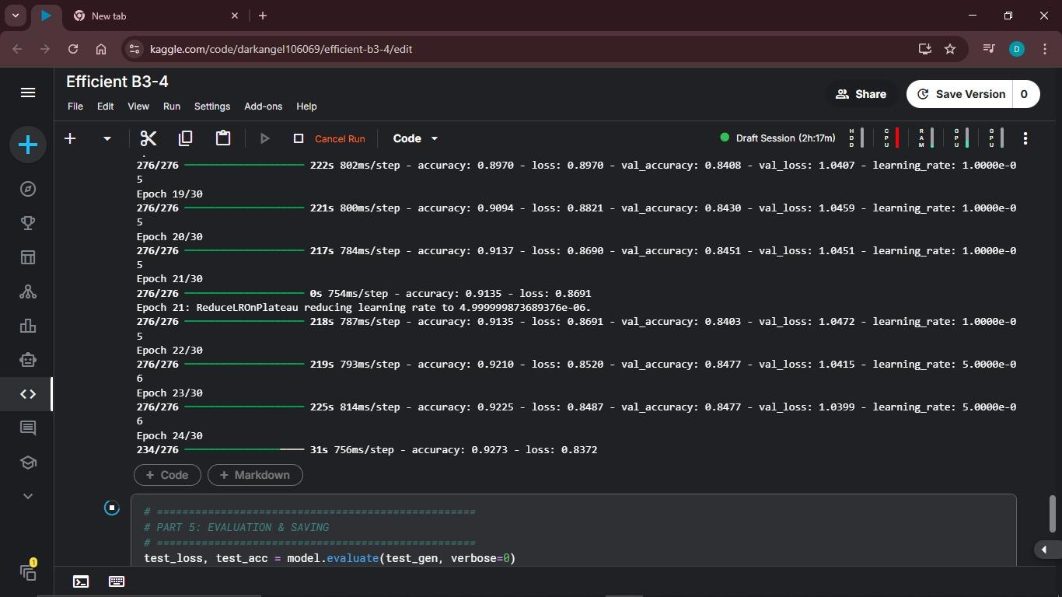
ML Model
EfficientNetB3 · Trained on Kaggle · Served via Gradio (Hugging Face)
Image Input
Training — Kaggle (EfficientNetB3)
01
User uploads JPG/PNG via dashboard
02
Pre-processing
Pillow: resize & normalize
03
Gradio Client
Flask calls EfficientNetB3 endpoint
04
Inference
Model returns label & confidence
Model:
Platform:
EfficientNetB3
Kaggle Notebook
05
Response
Label + Ticket ID sent to frontend
Serve via:
Output:
Gradio + HF Space
Label + Confidence
7

Slide 8
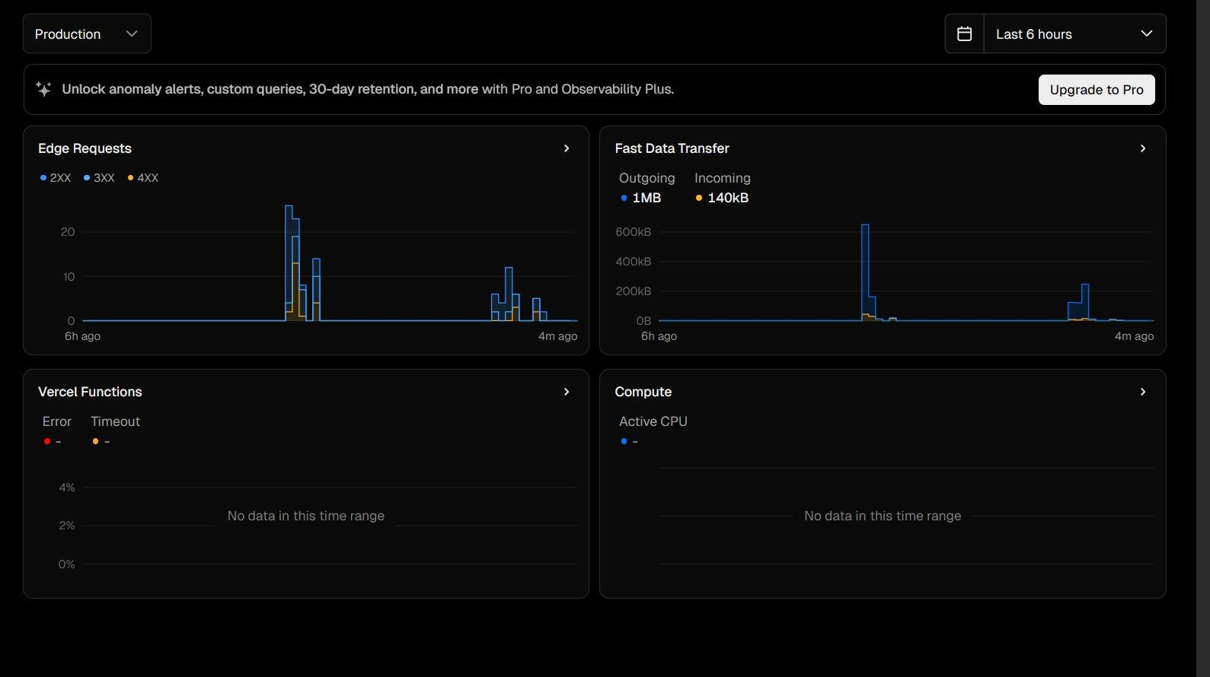
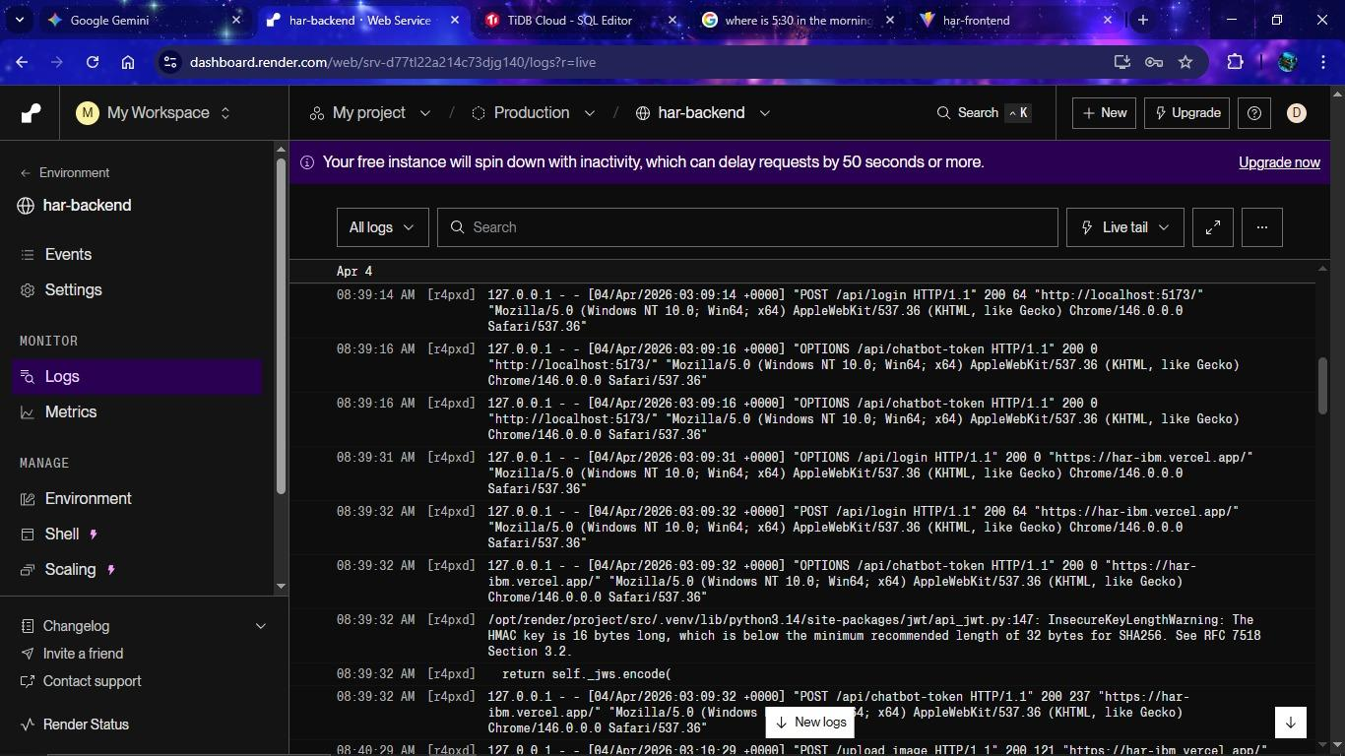
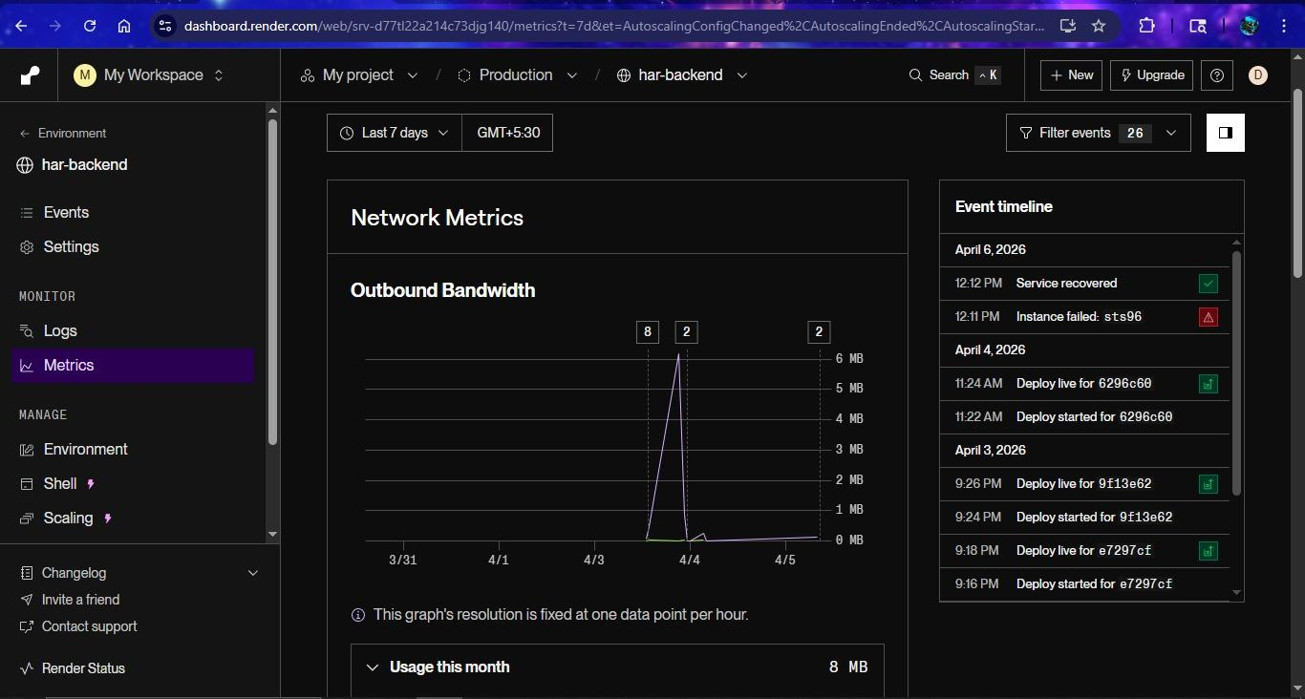
Deployment
Vercel · Render · TiDB Cloud · ImgBB
Vercel
Render
TiDB Cloud
ImgBB
Frontend
Backend
Database
Image Storage
Vercel Analytics
Render — Live Logs
Render — Network Metrics
All services communicate over HTTPS · CORS enabled · Free tier — cold start ~50s on first request
8

Slide 9
Future Scope
Planned improvements and next milestones
🤖 Fine-tune EfficientNetB3
🎫 Ticket Integration
📜 Enhanced History Page
Retrain on a larger, labelled custom dataset and deploy on IBM Watson ML for lower latency and higher accuracy.
Auto-generate unique tickets for every activity performed by any user.
Full-featured view with pagination, date filtering, Ticket ID search, and CSV export for audit trails.
🔐 JWT Token-Based Auth
🐳 Docker & CI/CD Pipeline
📊 Analytics Dashboard
Migrate from Flask-Login sessions to stateless JWT for scalable, secure API authentication.
Containerise with Docker Compose and add GitHub Actions for automated testing and zero-downtime deploys.
Admin panel with live charts showing activity trends, per-user stats, and model confidence distributions.
9

Slide 10
Thank You
HAR-Cloud · Human Activity Recognition
IBM SkillsBuild Internship Project · Ganpat University — ICT

